Slide 1
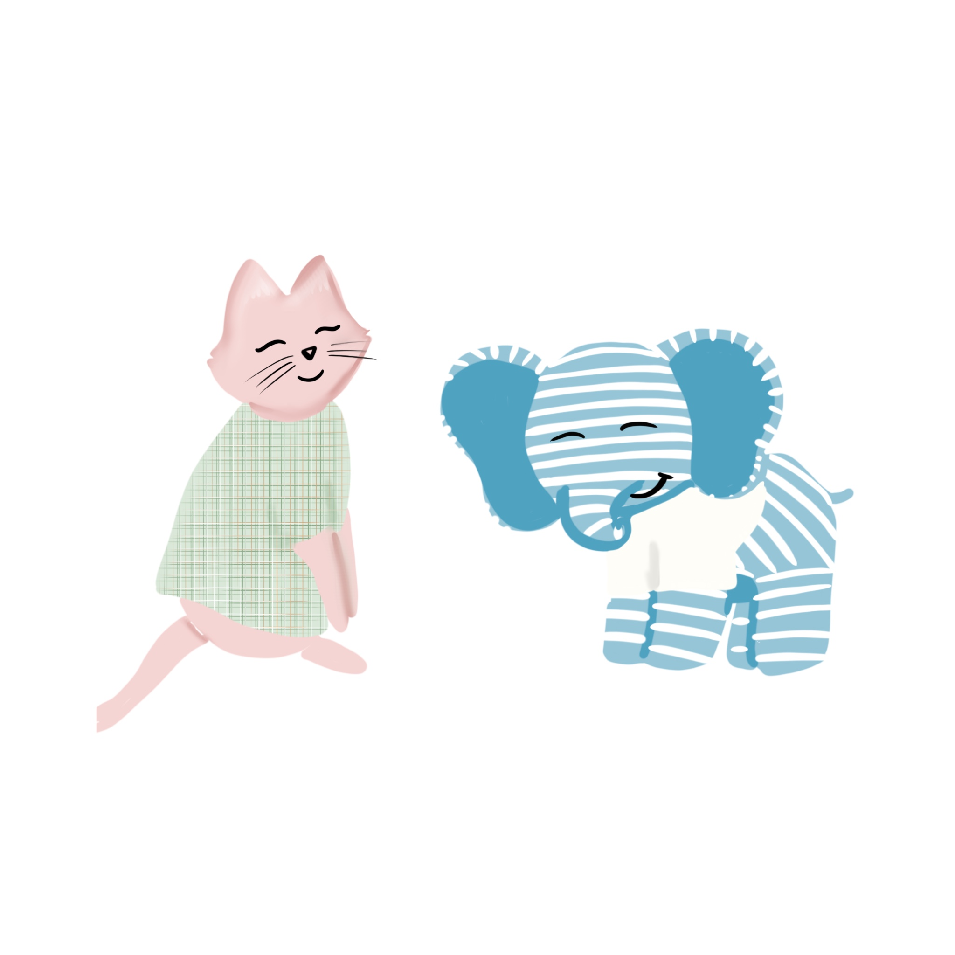
Problem Solving
with Kitty and Blue

Slide 2
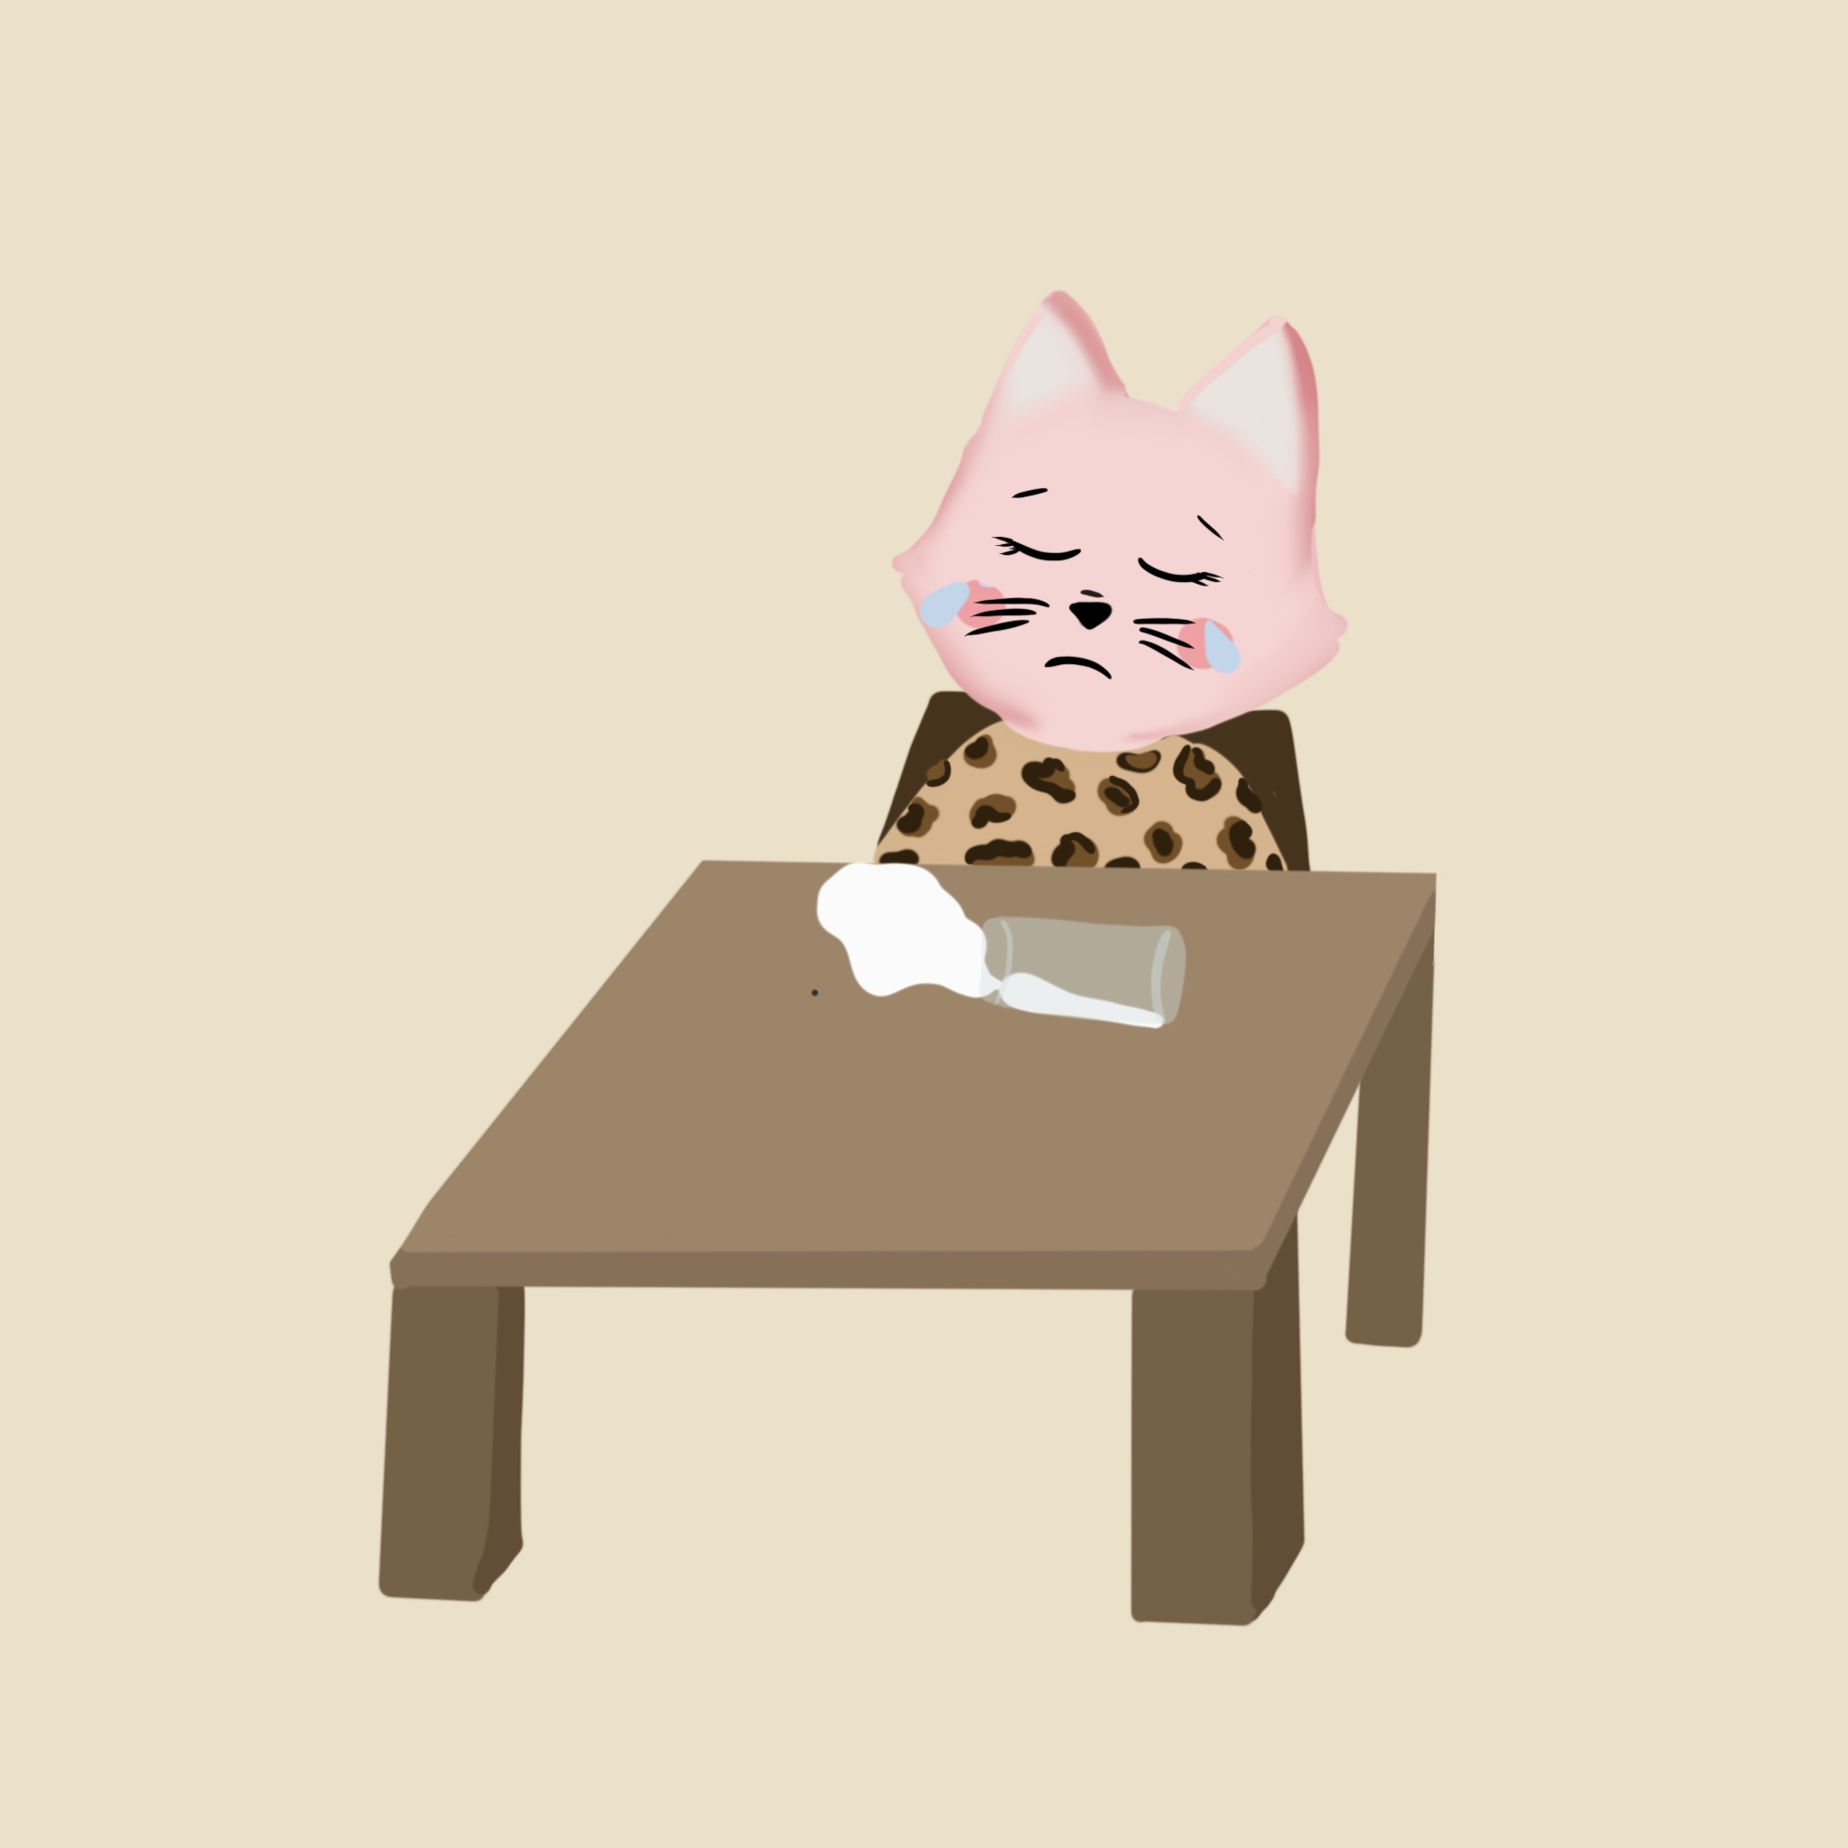
Kitty is so excited for her first day at school! She jumps out of bed and goes to find her favorite dress. She pulls it down from the closet, gets ready, and runs downstairs for breakfast. Kitty is happy to learn that Mom made her pancakes to celebrate her first day in person at school. She starts eating, but as she reaches across her plate to grab her cup of milk, she spills the milk all over her favorite dress. She’s almost late for the bus!
WHAT SHOULD KITTY DO?

Slide 3
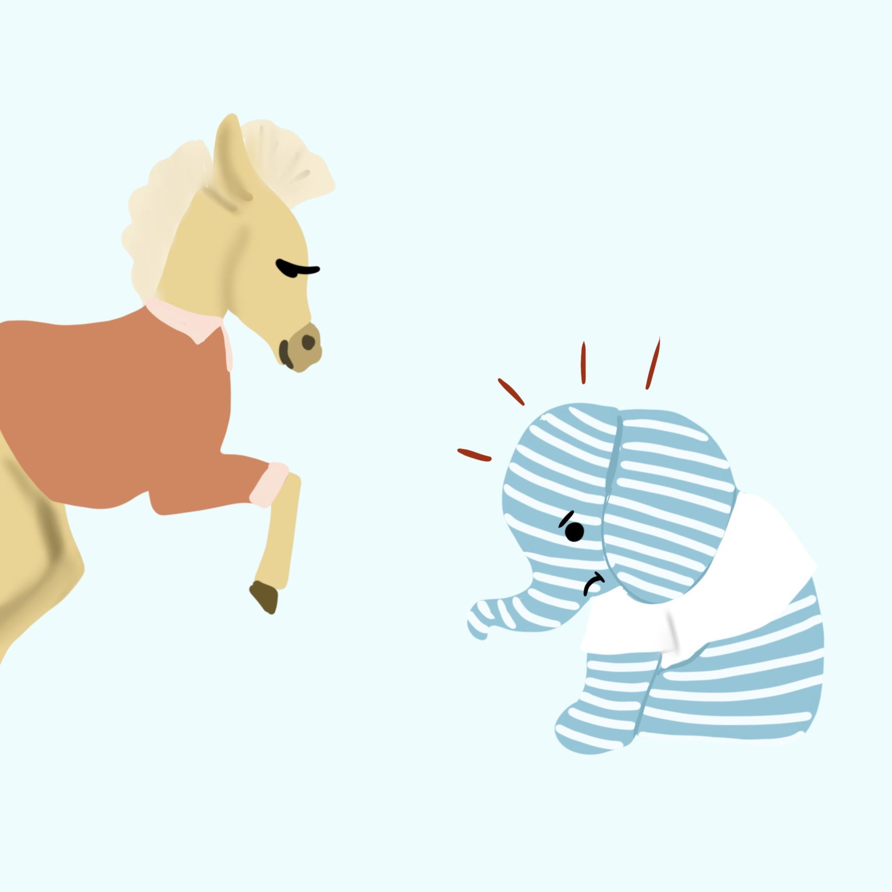
Blue is a little nervous about his first day coming to class in person. He slowly gets out of bed in the morning, but he manages to get himself dressed and into the kitchen, where his dad is waiting for him. Blue grabs a breakfast bar and they head out the door. When their car gets to school, Blue climbs out of the car and starts to walk into school. A bigger kid bumps right into him!
WHAT SHOULD BLUE DO?

Slide 4
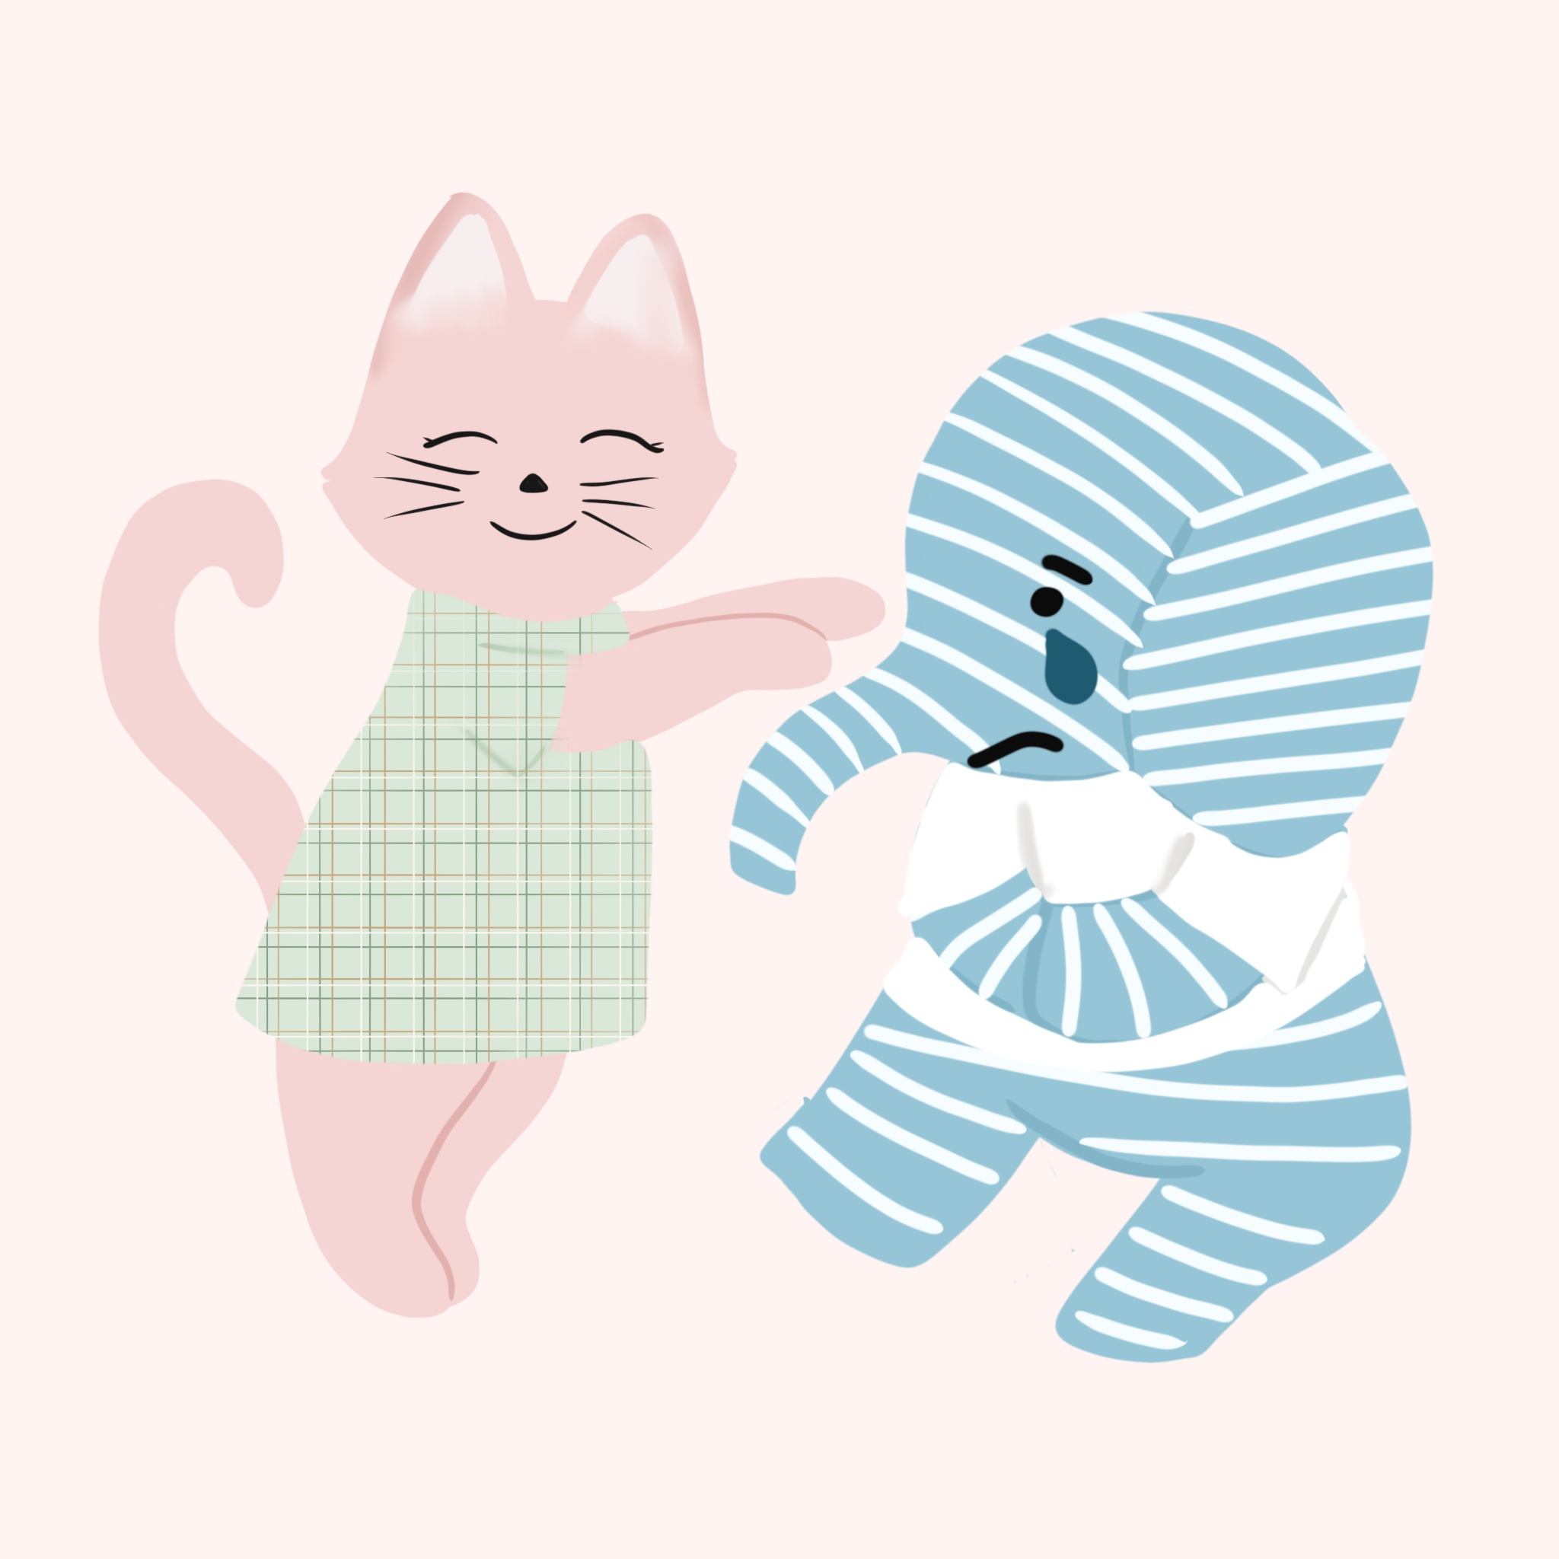
Kitty and Blue both make it into their kindergarten classroom. They meet their teacher, Mr. Murray. He welcomes them in and they find their tables with their names by them. Kitty is very excited to be there, and she gets too close to Blue. He gets a little nervous and yells “Go away!” Kitty feels mad that he yelled at her.
What should Kitty do? What should Blue do?

Slide 5
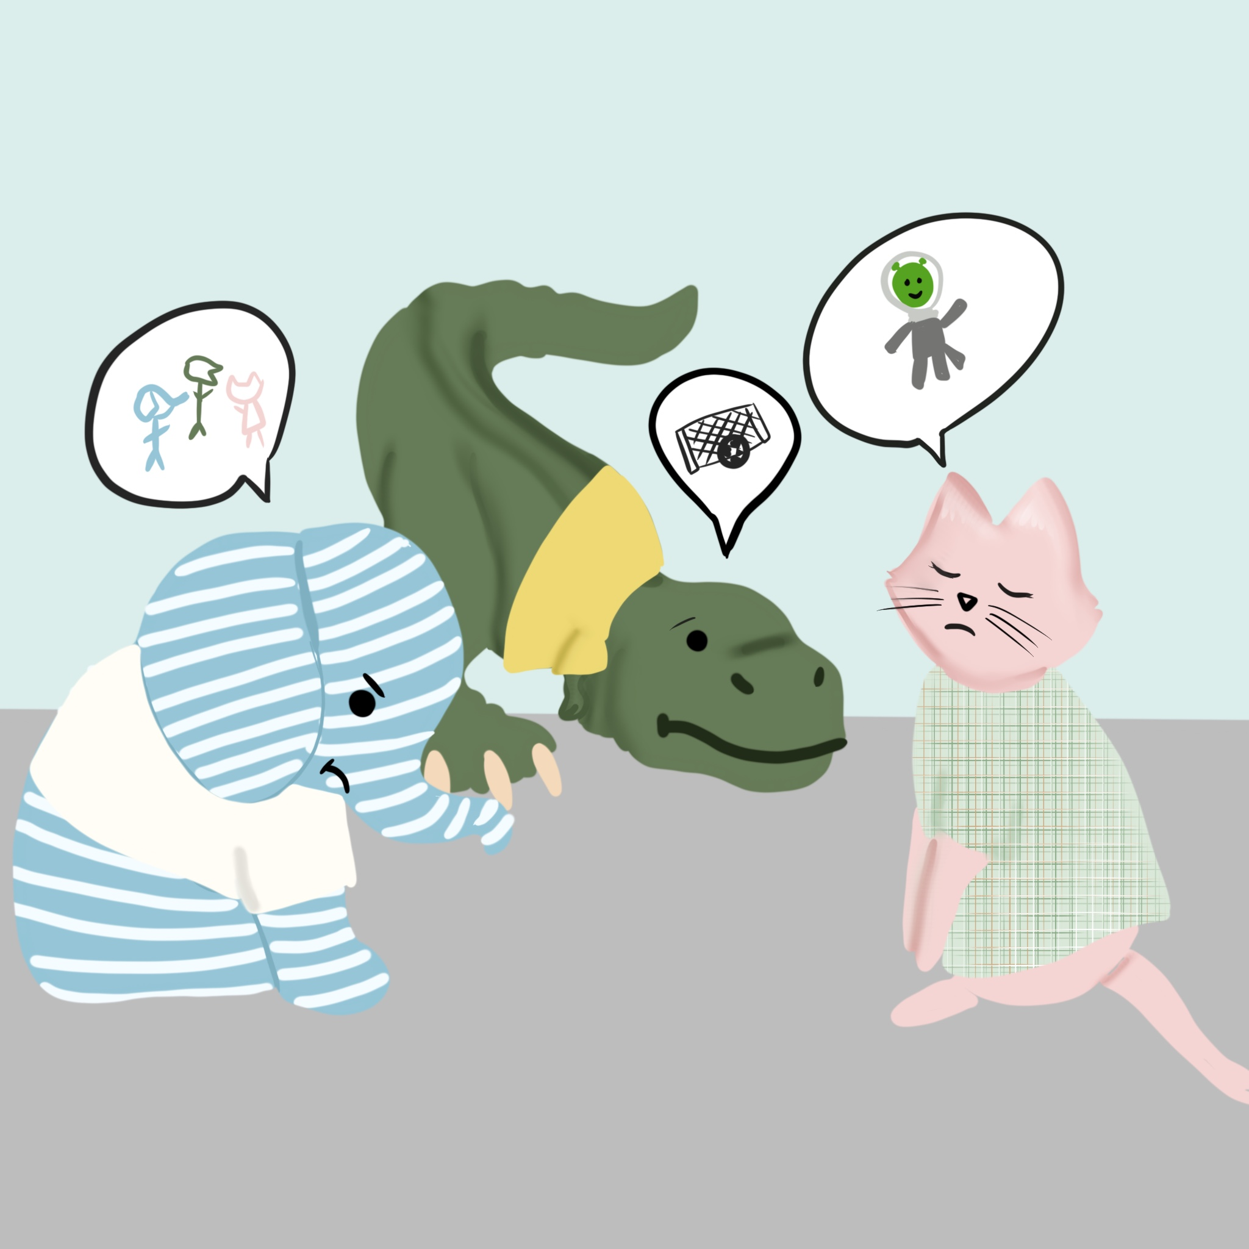
Kitty and Blue each made new friends at school. When they’re all out at recess, Kitty really wants to play space aliens. Blue shakes his head and says he wants to play tag. Rex says he’d rather play soccer. The three friends are frustrated.
How can they all have fun together?

Slide 6
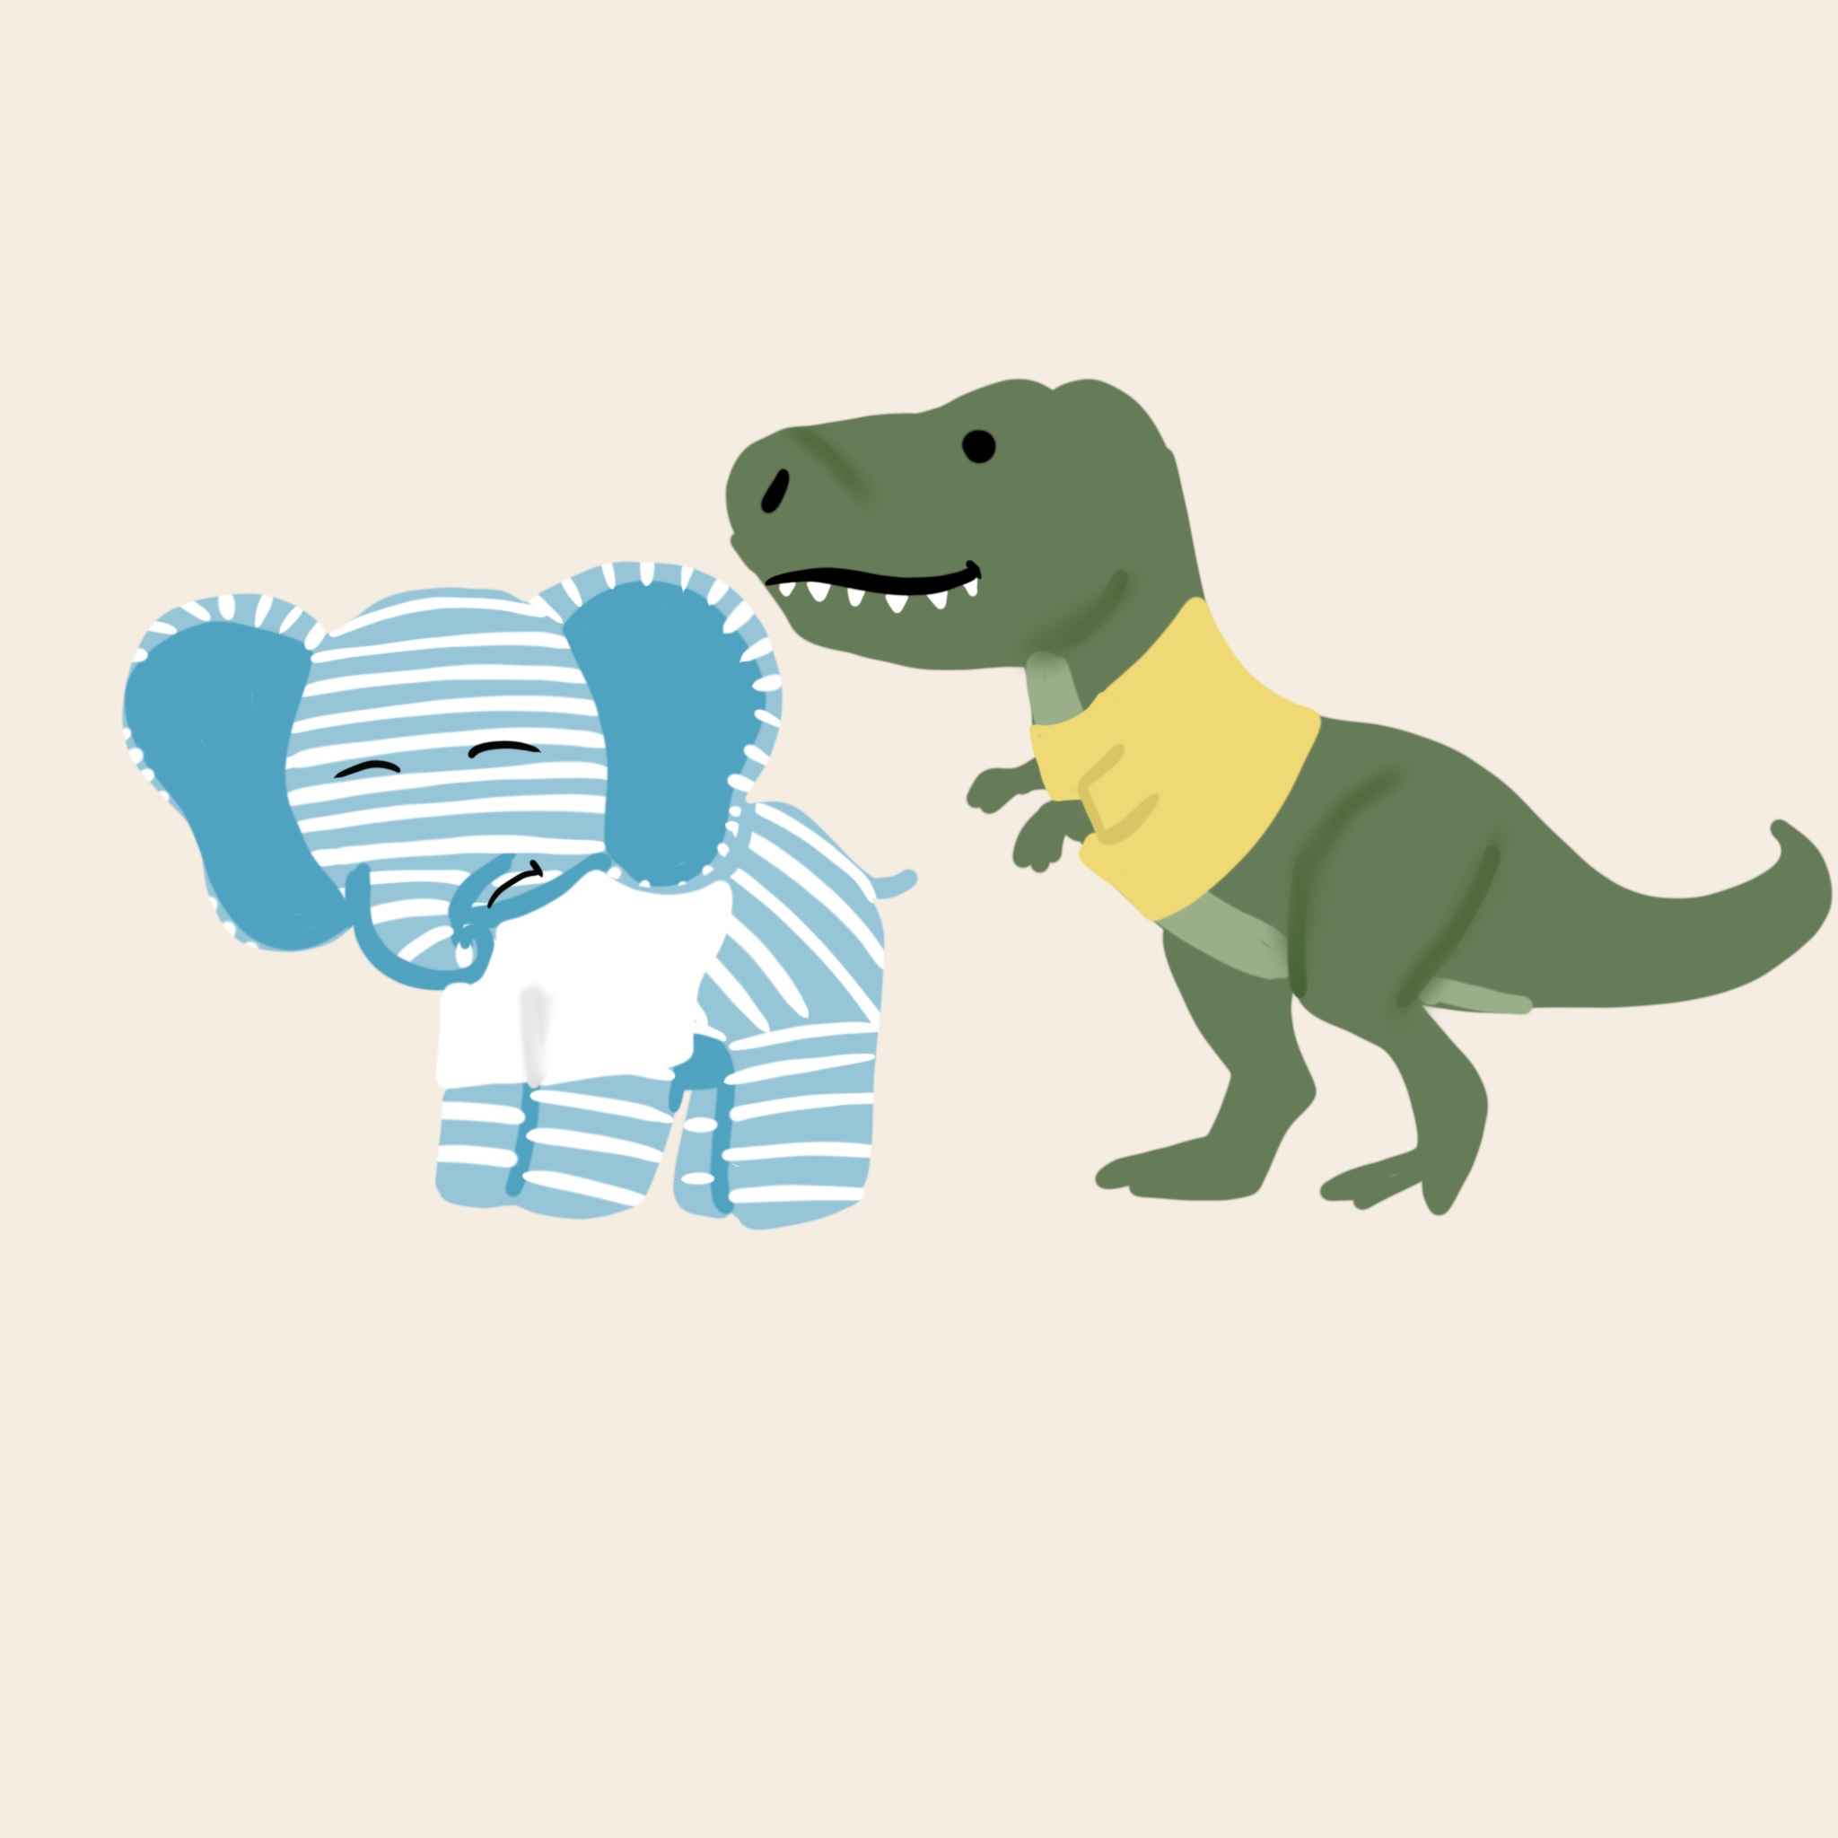
Kitty, Rex, and Blue grab their backpacks and get in line to go home at the end of the day. As they prepare to walk out the door, Blue doesn’t notice that the line has moved forward. Rex pushes Blue forward and says, “GOOOOOO!” Blue immediately starts crying.
How can Rex and Blue solve their problem?

Slide 7
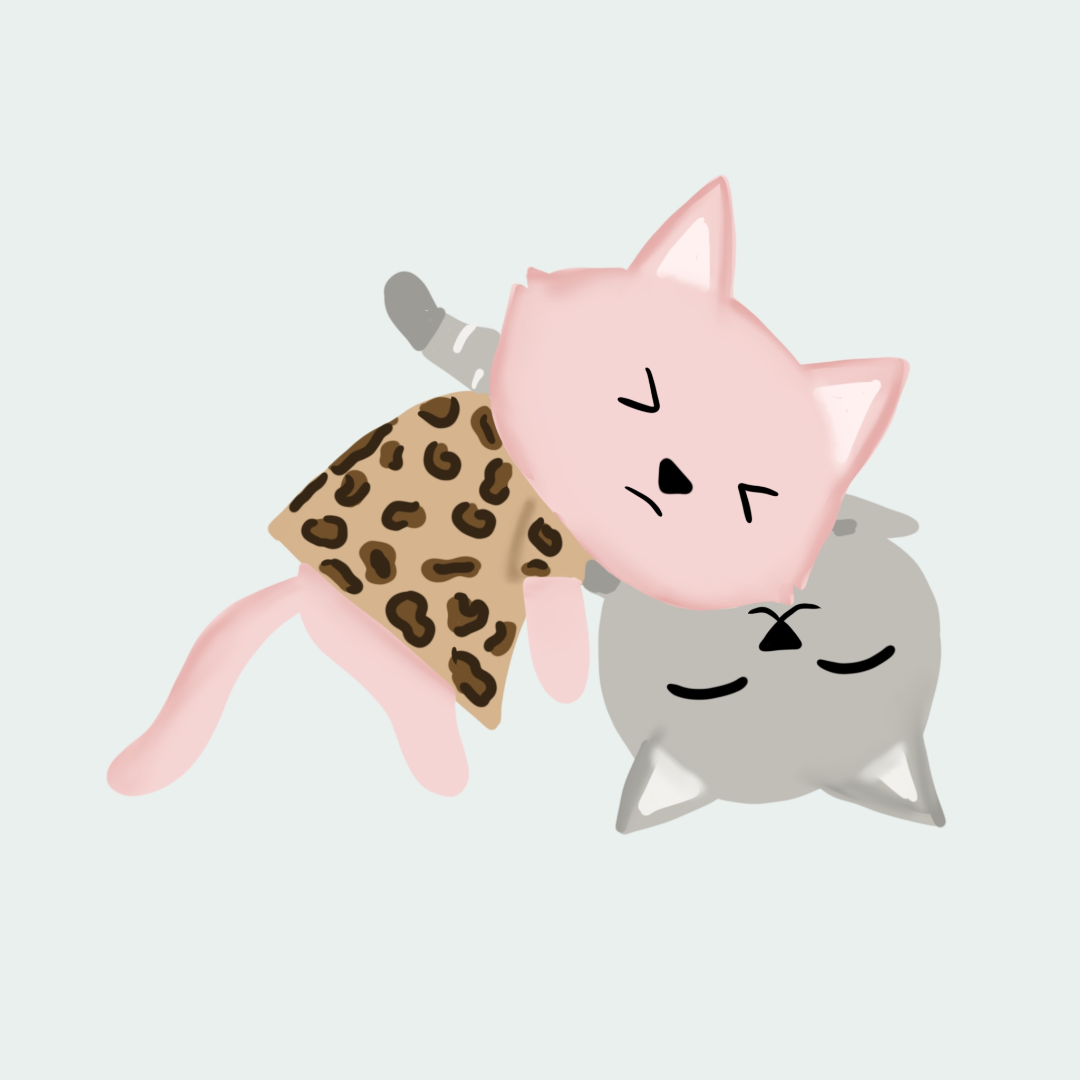
When Kitty gets home, her mom asks her how her day was. Kitty said it was a great day! Just as she’s trying to share more about her first day, her little brother Bobby interrupts her and starts talking about his own day very loudly. Kitty is annoyed that she was interrupted and annoyed that Bobby is so loud.
What should Kitty do?

Slide 8
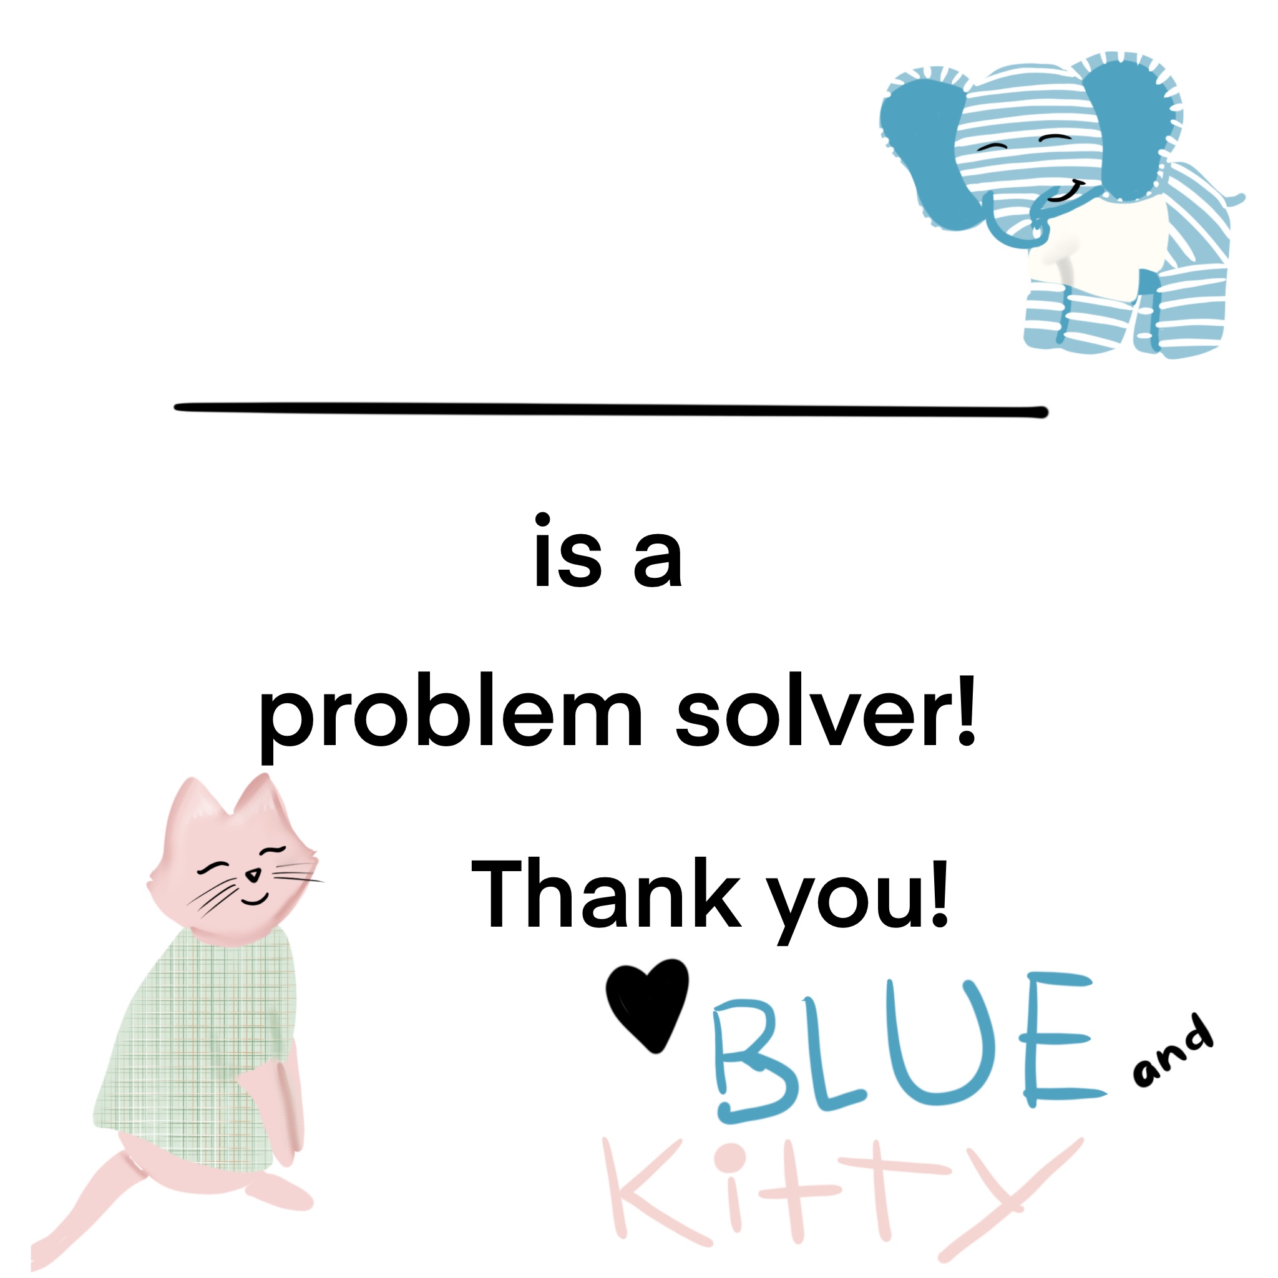
Thanks for helping Blue and Kitty solve their problems! You are all expert problem solvers now! Please accept this “Problem Solving Superhero” Award!

